Slide 1
The Open Grid Service Architecture (OGSA) Standard for Grid Computing
Prepared by: Haoliang Robin Yu

Slide 2
Overview
What is the Grid?
What is Grid-Computing?
What is the OGSA Standard?
Conclusions

Slide 3
What is the Grid?
System of computing resources performing tasks
There are 3 types of grids:
Data Grid
Computer Grid
Networking Grid
Example: LAN consisting of desktops, servers, storage, and databases
* Content from: http://www.sun.com/products/hpc/pdfs/grid.pdf

Slide 4
What is Grid-Computing?
The sharing of distributed computer applications, data, resources
Content from http://www.platform.com/grid/

Slide 5
Examples of Grid-Computing
Processing jobs at remote computer
Accessing a remote database
Running a remote program
* Content from http://www.platform.com/grid/

Slide 6
Benefits of Grid-Computing
Increase personal productivity
Increase corporate productivity
Reduce product time to market
Increase return on investments
* Content from: http://www.sun.com/products/hpc/pdfs/grid.pdf

Slide 7
Barriers to Grid Implementation
Degree of teamwork and information sharing
Geographic location, languages, cultural separation
* Content from http://www.platform.com/adoption/politics/index.asp

Slide 8
What is the OGSA Standard?
Acronym for Open Grid Service Architecture
OGSA define how different components in grid interact
* Content from http://www.-106.ibm.com/developerworks/grid/library/gr-visual/index.html?ca=dgr-lnxw…

Slide 9
Architecture of OGSA
Comprised of 4 main layers
Physical and Logical Resources Layer
Web Service Layer
OGSA Architected Grid Services Layer
Grid Applications Layer
* Content from http://www.-106.ibm.com/developerworks/grid/library/gr-visual/index.html?ca=dgr-lnxw…

Slide 10
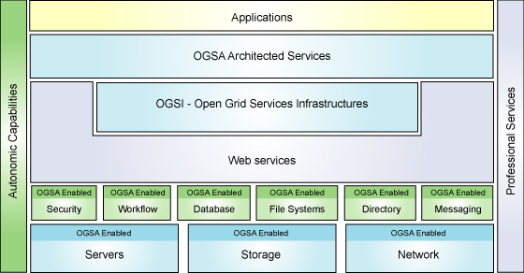
OGSA Architecture
* Content from http://www. 106.ibm.com/developerworks/grid/library/gr-visual/index.html?ca=dgr-lnxw…

Slide 11
OGSA Architecture - Physical and Logical Resources Layer
Physical resources are: servers, storage, network
Logical resources manage physical resources
Examples of logical resources: database managers, workflow managers
* Content from http://www.-106.ibm.com/developerworks/grid/library/gr-visual/index.html?ca=dgr-lnxw…

Slide 12
OGSA Architecture - Web Services Layer
Web service is software available online that could interact with other software using XML
Consists of Open Grid Services Infrastructure (OGSI) sub-layer which specifies grid services and provide consistent way to interact with grid services
Also extends Web Service Capabilities
* Content from http://www. 106.ibm.com/developerworks/grid/library/gr-visual/index.html?ca=dgr-lnxw…

Slide 13
OGSA Architecture - Web Services Layer (OGSI) (continued)
Consists of 5 interfaces:
Factory: provide way for creation of new grid services
Life Cycle: Manages grid service life cycles
State Management: Manage grid service states

Slide 14
OGSA Architecture - Web Services Layer (OGSI)
Consists of 5 interfaces:
Service Groups: collection of indexed grid services
5. Notification: Manages notification between services & resources
* Content from http://www.-106.ibm.com/developerworks/grid/library/gr-visual/index.html?ca=dgr-lnxw…

Slide 15
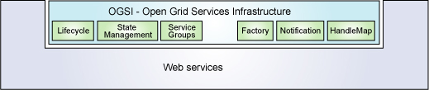
OGSA Architecture - Web Services Layer (OGSI)

Slide 16
OGSA Architecture – OGSA Architected Services - Layer
Classified into 3 service categories
Grid Core Services
Grid Program Execution Services
Grid Data Services
* Content from http://www. 106.ibm.com/developerworks/grid/library/gr-visual/index.html?ca=dgr-lnxw…

Slide 17
OGSA Architected Services – Grid Core Services
Composed of 4 main types of services:
Service Management: assist in installation, maintenance, & troubleshooting tasks in grid system
Service Communication: include functions that allow grid services to communicate
* Content from http://www.-106.ibm.com/developerworks/grid/library/gr-visual/index.html?ca=dgr-lnxw…

Slide 18
OGSA Architected Services – Grid Core Services (continued)
Composed of 4 main types of services:
3. Policy Services: Provide framework for creation, administration & management of policies for system operation
4. Security Services: provide authentication & authorization mechanisms to ensure systems interoperate securely

Slide 19
OGSA Architected Services – Grid Program Execution Services
Supports unique grid systems in high performance computing, collaboration, parallelism
Support virtualization of resource processing
* Content from http://www.-106.ibm.com/developerworks/grid/library/gr-visual/index.html?ca=dgr-lnxw…

Slide 20
OGSA Architected Services – Grid Data Services
Support data virtualization
Provide mechanism for access to distributed resources such as databases, files
* Content from http://www.-106.ibm.com/developerworks/grid/library/gr-visual/index.html?ca=dgr-lnxw…

Slide 21
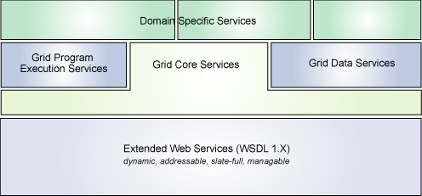
OGSA Architecture – OGSA Architected Services - Layer

Slide 22
OGSA Architecture – Grid Applications Layer
This layer comprise of applications that use the grid architected services
* Content from http://www.-106.ibm.com/developerworks/grid/library/gr-visual/index.html?ca=dgr-lnxw…

Slide 23
Conclusion
Grid-Computing allows networked resources to be combined and used
Grid-Computing offers great benefit to an organization
OGSA are comprehensive standards which governs grid-computing

Slide 24
References
* Content from: http://www.sun.com/products/hpc/pdfs/grid.pdf
Content from http://www.platform.com/grid/
http://www.sun.com/products/hpc/pdfs/grid.pdf
http://www.platform.com/adoption/politics/index.asp
* Content from http://www.-106.ibm.com/developerworks/grid/library/gr-visual/index.html?ca=dgr-lnxw…

Slide 25
Questions???

